Slide 1
Number Theory
Chapter 1: Divisibility and Congruence

Slide 2

1.Divisibility
Words and Expressions
suppose that 假设
integer n. 整数
devide v. 整除
$a,b∈ ℤ, a≠0$,
$$a | b ⟺ ∃k∈ ℤ, b=ka$$
Example:
$$2 | 6 and 7| 14$$

Slide 3
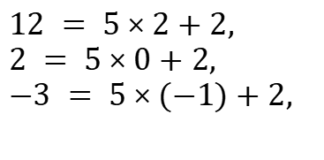
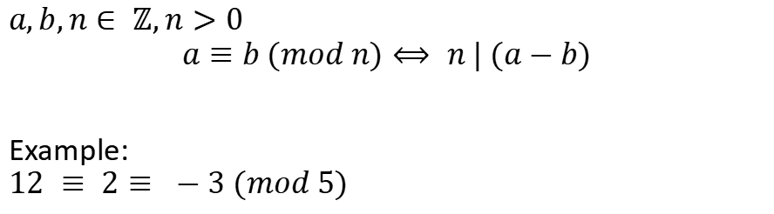
2.Congruence
Words and Expressions
be congruent to 同余
mod (modulo) 模
bracket n. 括号
remainder n. 余数
$$a,b,n∈ ℤ,n>0$$
$$a≡b (mod n)⟺ n | (a−b)$$
Example:
$$12 ≡ 2≡ −3 (mod 5)$$
$$12 = 5×2+2,$$
$$2 = 5×0+2,$$
$$−3 = 5×(−1)+2,$$

Slide 4

2.Congruence
$$a,b,c,d,n∈ ℤ,n>0$$
$$If a≡c (mod n), b≡d (mod n), then$$
$$1.a+b≡c+d (mod n)$$
$$2.ab≡cd (mod n)$$

Slide 5
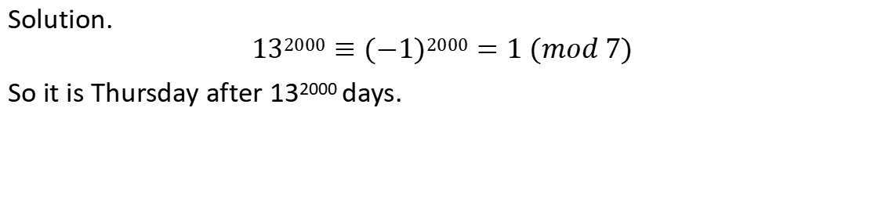
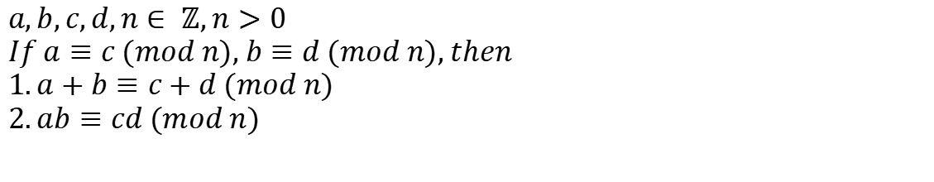
Question 1: If it’s Wednesday today, What day is it after 13²⁰⁰⁰ days?
Solution.
$$132000≡(−1)2000=1 (mod 7)$$
So it is Thursday after 13²⁰⁰⁰ days.
$$a,b,c,d,n∈ ℤ,n>0$$
$$If a≡c (mod n), b≡d (mod n), then$$
$$1.a+b≡c+d (mod n)$$
$$2.ab≡cd (mod n)$$

Slide 6
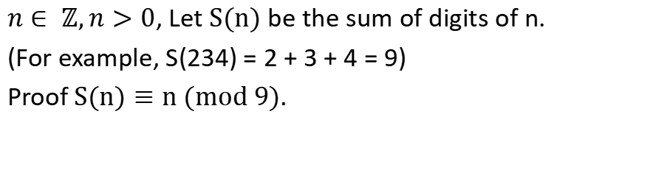
Exercise
Words and Expressions
digit n.数字
$n∈ ℤ,n>0$, Let $S(n)$ be the sum of digits of n.
(For example, S(234) = 2 + 3 + 4 = 9)
Proof $S(n)≡n (mod 9).$

